Slide 1
Cancer Detection
Sprint1
10/2/2017
Notes:
‹#›
To Do: Trello and github links

Slide 2
Team members
Shuang Zhao: Found out about cancer, background and user stories.
Lijun Xiao: Looked at different machine learning things and decided which library to use.
Zhexi Zhang: Found some references and design the high level system diagram.
John Curci: Looked at the Kernels and learned how to parse the data.
‹#›

Slide 3
Product Statement
*
This product is for cancer researchers who need to classify large numbers of genetic mutations using information from the scientific literature. The tool is a machine learning algorithm that parses the information contained in scientific papers automatically. Compared to reading journal articles manually, this tool will dramatically reduce the amount of time required to classify mutations.
‹#›

Slide 4
User Stories
*
I want to be able to extract information from large number of scientific papers quickly without reading them.
I want to be able to input multiple gene/variation/text sets at once by uploading ASCII files.
I want to be able to easily input papers one at a time using text fields.
I want to be able to access and use the tool without working in the command line.
I want to be able to run the tool using only a laptop or a smartphone with an internet connection.
‹#›

Slide 5
Minimum Valuable Product
*
Scientists are able to extract information from large number of scientific papers quickly without reading them and get the classification of the genetic mutations.
‹#›
Notes:
-Algorithm can extract information from a large number of scientific papers quickly without intervention from the user.
-The algorithm can classify genetic mutations as accurately as possible based on the information in the papers.

Slide 6
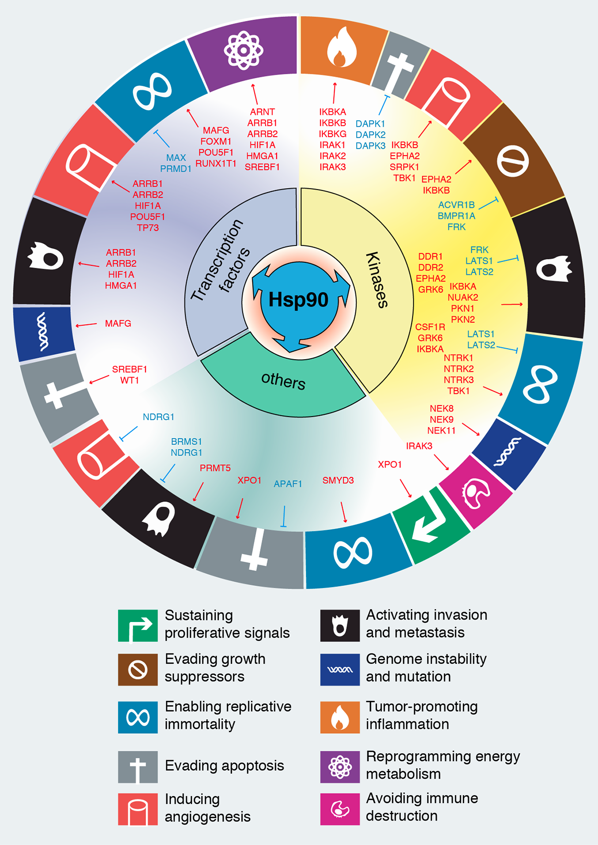
Background: Mutations and cancer
*
All cancers begin when one or more genes in a cell are mutated, or changed, which can cause cells to multiply uncontrollably and become cancerous.
Despite all that is known about the different ways cancer genes work, many cancers cannot be linked to a single gene. Cancer likely involves multiple gene mutations. Some evidence also suggests that genes interact with their environment, further complicating genes’ role in cancer.
‹#›
Notes:
All cancers begin when one or more genes in a cell are mutated, or changed, which can cause cells to multiply uncontrollably.
Despite all that is known about the different ways cancer genes work, many cancers cannot be linked to a single gene. Cancer involves multiple gene mutations. Some evidence also suggests that genes interact with their environment, further complicating genes’ role in cancer.

Slide 7
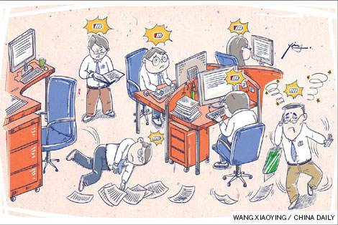
Once formed, a cancer tumor can have thousands of genetic mutations. But the challenge is distinguishing the mutations that contribute to tumor growth.
This interpretation of genetic mutations is being done manually currently. This is a very time-consuming task that a clinical pathologist has to review and classify every single genetic mutation based on evidence from text-based clinical literature manually.
Notes:
Once formed, a cancer tumor can have thousands of genetic mutations. The challenge is distinguishing between “driver” mutations that contribute to tumor growth, and “passenger” mutations that exist in cancerous cells but are not responsible for cancer.
This interpretation of genetic mutations is currently being done manually. A molecular pathologist has to review and classify every single genetic mutation based on evidence from the scientific literature, and the process is very time consuming.

Slide 8

High Level System Diagram
*
Training Data
Information Extraction
Database
Web App
Classification
‹#›

Slide 9
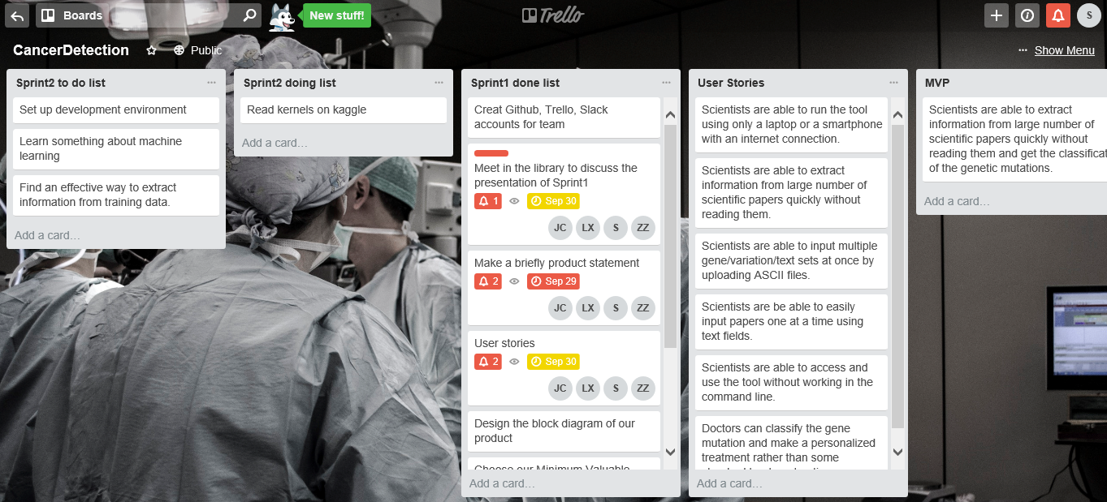
GitHub(https://github.com/ShuangZhao95/EC601-Cancer-Detection)
Trello(https://trello.com/b/tEEyg11e/cancerdetection)
*
‹#›

Slide 10
Challenges
*
Extracting information from text without human assistance is inherently difficult
The tool needs to distinguish between useful and non-useful information in a large text file
The learning process is computationally intensive, due to the large (~300MB) size of the training data
A web application is needed to allow the user to interact with the database
‹#›
Notes:
Characters per entry is roughly equal to the number of entries.

Slide 11
Next Sprint
Implement the SciKit-Learn library
Format data files for input to SciKit-Learn
Move all code into development environment
Determine general strategy for an algorithm using SciKit-Learn
‹#›

Slide 12
Thank You

